Slide 1

Image Steganography
This project focused on image steganography.

Slide 2
Student Details
Name: Dasari Dolly Vara Kaarthika
SkillsBuild Email ID : dollyvarakaarthika@gmail.com
College Name : KL UNIVERSITY
Group: CSE
College State : Andhra Pradesh
Internship Domain and Internship Start and End Date: CyberSecurity Using Kali Linux L 3 June 2024 to 15 July 2024

Slide 3

Hiding Text Inside an Image
This project focused on hiding text inside an image.
1
Steganography
2
Image Embedding
The art of concealing information
Text hidden within the image's pixels
3
Security
4
Applications
Enhancing data confidentiality
From secret messages to digital watermarking

Slide 4

Project Overview
This project explored image steganography.
1
Text Encoding
Conversion of text to binary code
2
Pixel Manipulation
Modifying image pixels to embed the code
3
Decoding & Retrieval
Extracting the hidden text from the image
4
Security & Analysis
Assessing the robustness of the method

Slide 5

End Users of the Project
The project was designed for various users.
Security Professionals
Researchers
Protecting sensitive data
Exploring new steganography techniques
Hobbyists
Artists
Learning about information security
Embedding hidden messages within their art

Slide 6

Project Solution & Value
The project offered a practical solution.
Solution
Image Steganography Technique
Value
Enhanced data security, confidentiality, and covert communication

Slide 7





Project Customization
The project was customized to meet specific requirements.
Algorithm Selection
Choosing a suitable steganographic algorithm
Implementation
Using programming languages for code implementation
Testing & Evaluation
Thoroughly testing the functionality and security
Documentation
Providing clear documentation for future users

Slide 8




Project Modeling
The project involved modeling the steganography process.
Algorithm Design
Defining the core logic for embedding and extracting text
Data Structures
Representing image pixels, text, and embedding parameters
Security Analysis
Evaluating the robustness of the method against attacks

Slide 9
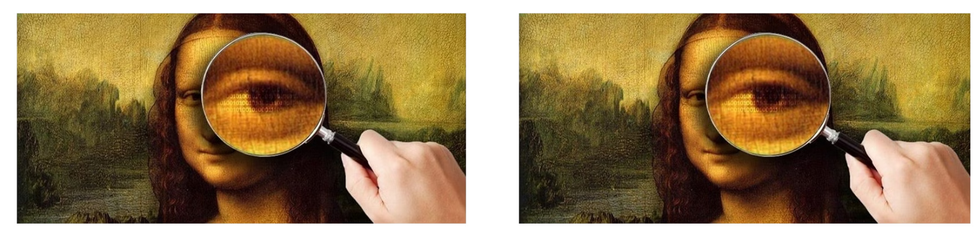
Project Results
Original image
Encrypted image

Slide 10
THANK YOU

